Slide 1
RxJS Introduction
Jin Wei
13/12/2019

Slide 2
Agenda
What’s RxJS
Core concepts in RxJS
Observable
Operator
Subject
Scheduler

Slide 3

What’s RxJS
“RxJS (The Reactive Extensions for JavaScript) is a library for composing asynchronous and event-based programs by using observable sequences.”
——reactivex.io/rxjs

Slide 4
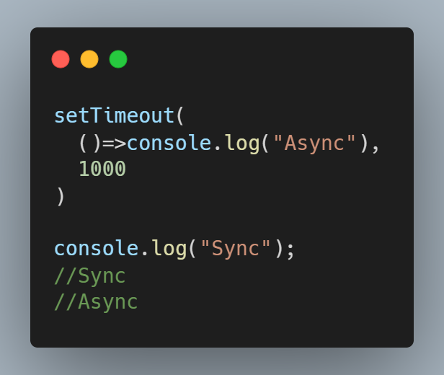
Asynchronous Programming in JavaScript
setTimeout/setInterval
Promises (introduced in ES6)
Async/Await (introduced in ES8)
RxJS Observables

Slide 5
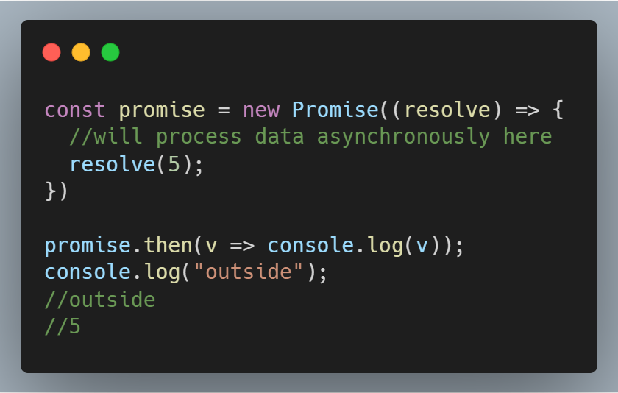
Asynchronous Programming in JavaScript
setTimeout/setInterval
Promises (introduced in ES6)
Async/Await (introduced in ES8)
RxJS Observables

Slide 6
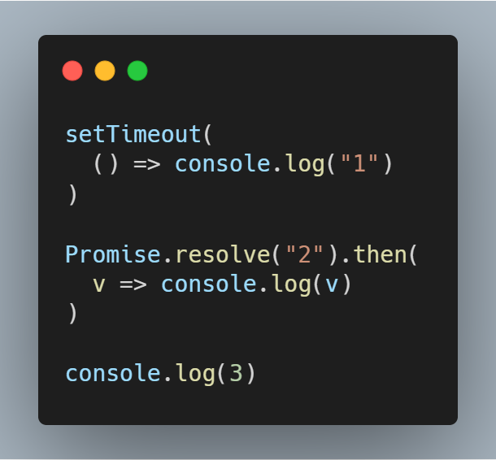

Asynchronous Programming in JavaScript
setTimeout/setInterval
Promises (introduced in ES6)
Async/Await (introduced in ES8)
RxJS Observables

Slide 7
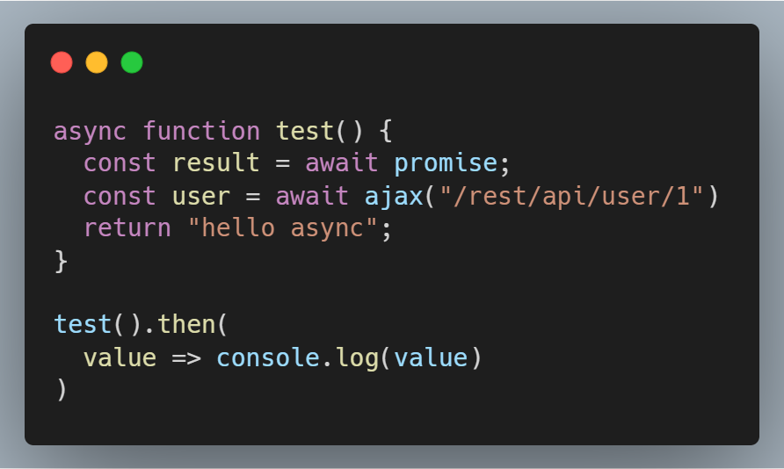
Asynchronous Programming in JavaScript
setTimeout/setInterval
Promises (introduced in ES6)
Async/Await (introduced in ES8)
RxJS Observables

Slide 8

Asynchronous Programming in JavaScript
setTimeout/setInterval
Promises (introduced in ES6)
Async/Await (introduced in ES8)
RxJS Observables

Slide 9
Why to use RxJS?
The ability to handle multiple asynchronous events
Cancelable
Deliver multiple values
Synchronous or asynchronous
Provide many data stream operators
……

Slide 10
Core Concepts in RxJS
Observable: represents the idea of an invokable collection of future values or events.
Observer: is a collection of callbacks that knows how to listen to values delivered by the Observable.
Subscription: represents the execution of an Observable, is primarily useful for cancelling the execution.
Operator: are pure functions that enable a functional programming style of dealing with collections with operations like map, filter, concat, reduce, etc.
Subject: is an Observable and an Observer, and the only way of multicasting a value or event to multiple Observers.
Scheduler: are centralized dispatchers to control concurrency, allowing us to coordinate when computation happens on e.g. setTimeout or requestAnimationFrame or others.

Slide 11
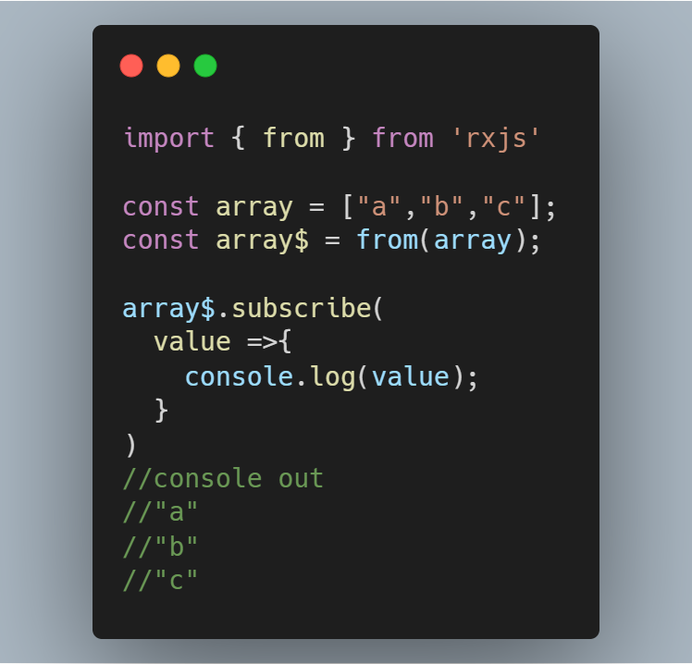
Create An Observable
from()
of()
fromEvent()
timer()
Interval()

Slide 12
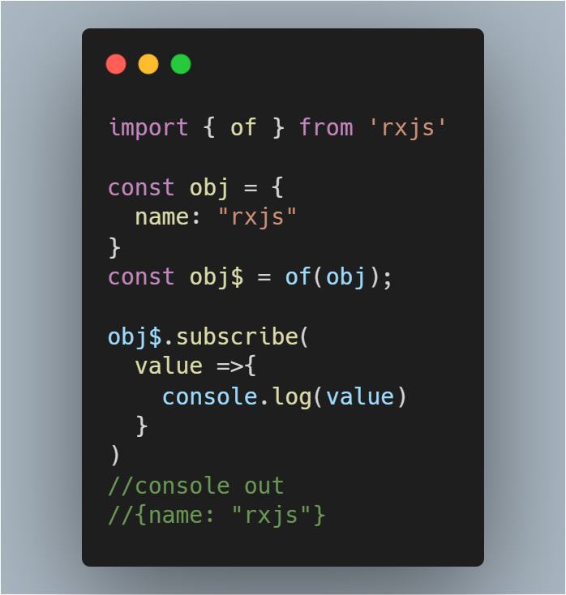
Create An Observable
from()
of()
fromEvent()
timer()
Interval()

Slide 13
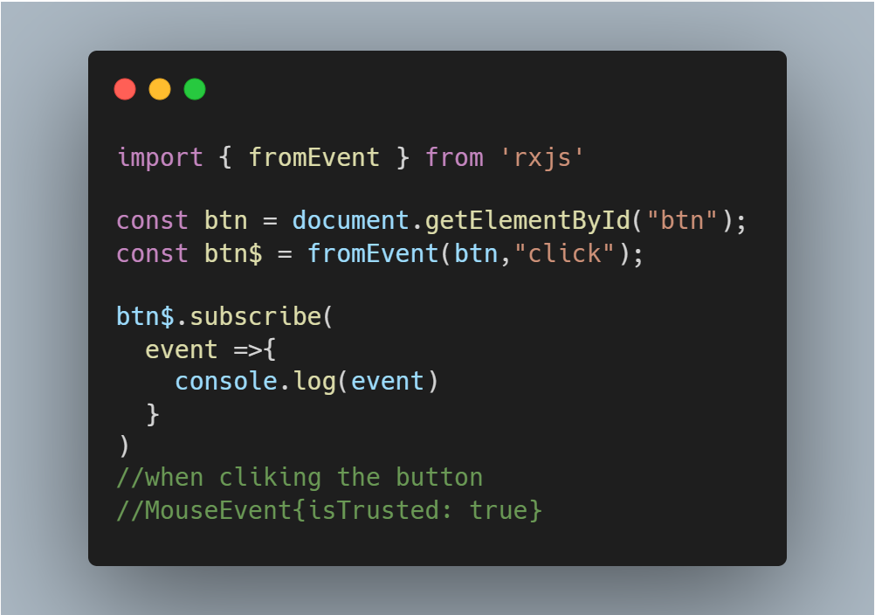
Create An Observable
from()
of()
fromEvent()
timer()
Interval()

Slide 14
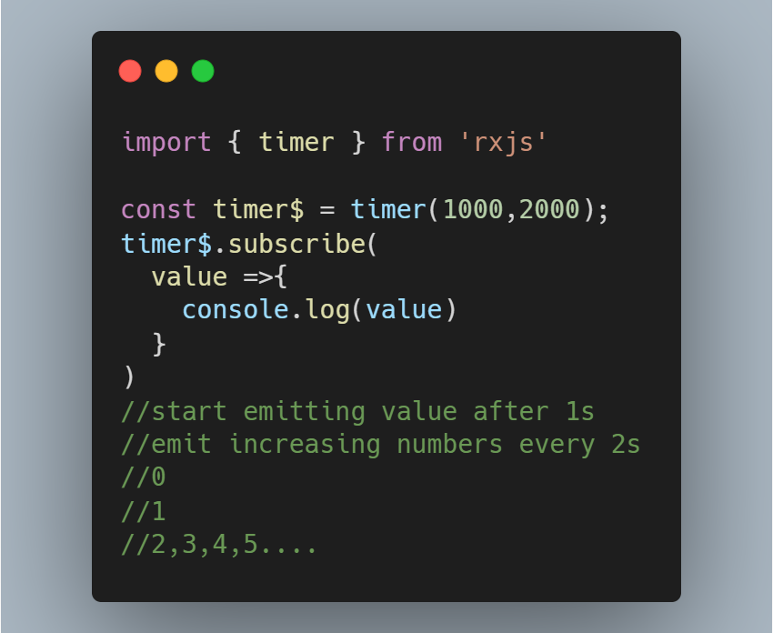
Create An Observable
from()
of()
fromEvent()
timer()
Interval()

Slide 15
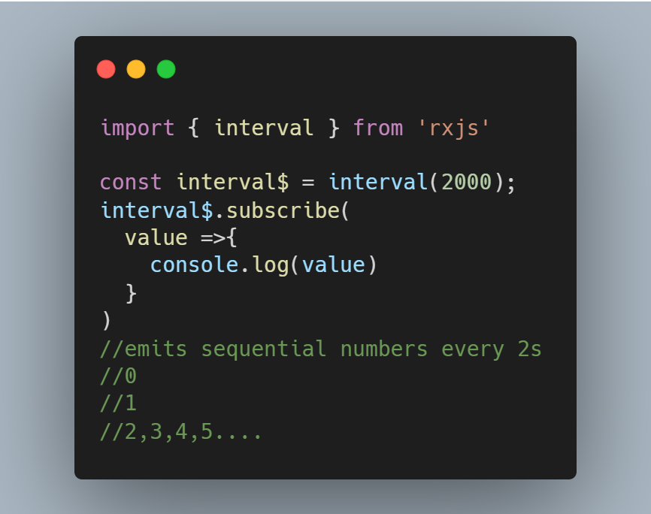
Create An Observable
from()
of()
fromEvent()
timer()
Interval()

Slide 16
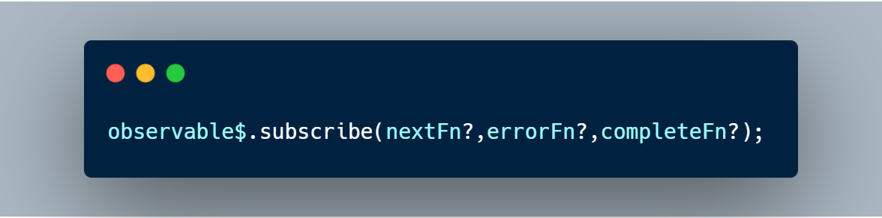
Subscribing to Observables
The observable’s subscribe method allows you to pass three callback methods as parameters.
Whenever the data arrives, the nextFn will be invoked to process the data.
Before the data arrives if an exception happens, the errorFn will be invoked to handle the error.
When all the data has been emitted successfully, the completeFn will be invoked.
If error occurred, the afterwards data will not be delivered and the completeFn will be not invoked.

Slide 17
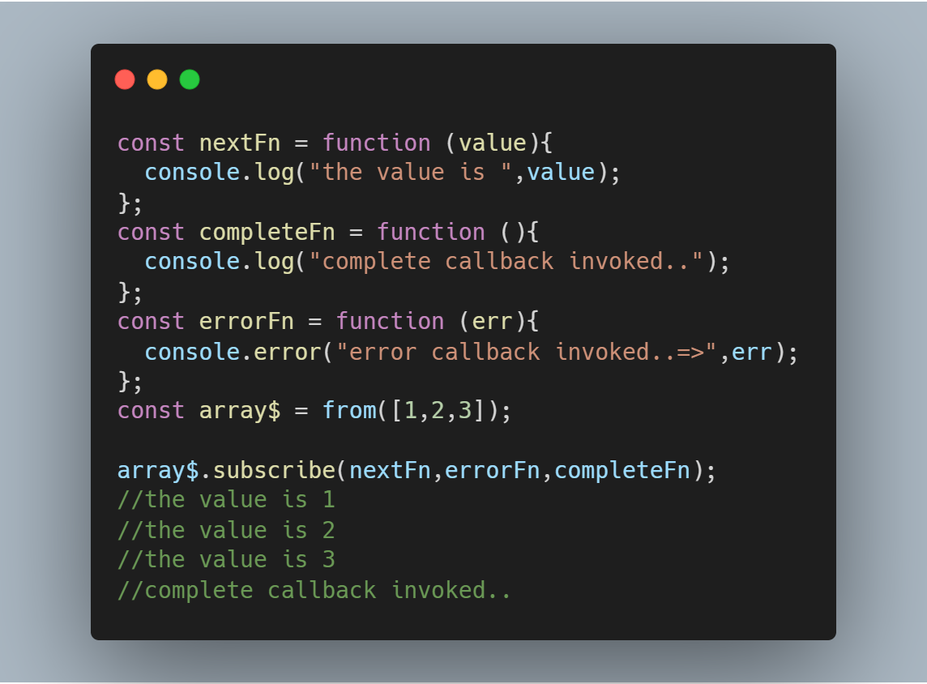
Subscribing to Observables

Slide 18
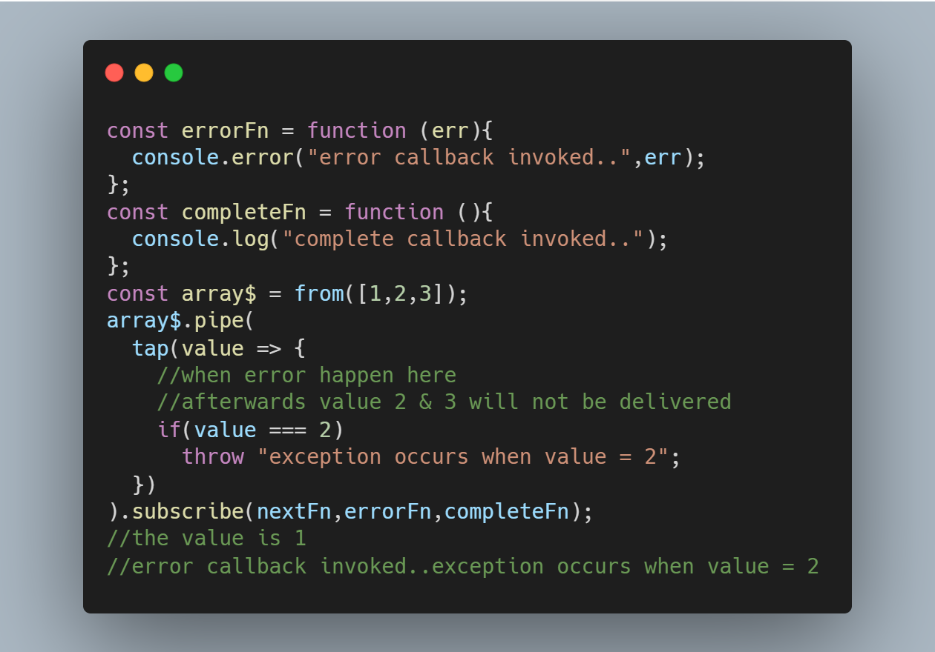
Subscribing to Observables

Slide 19
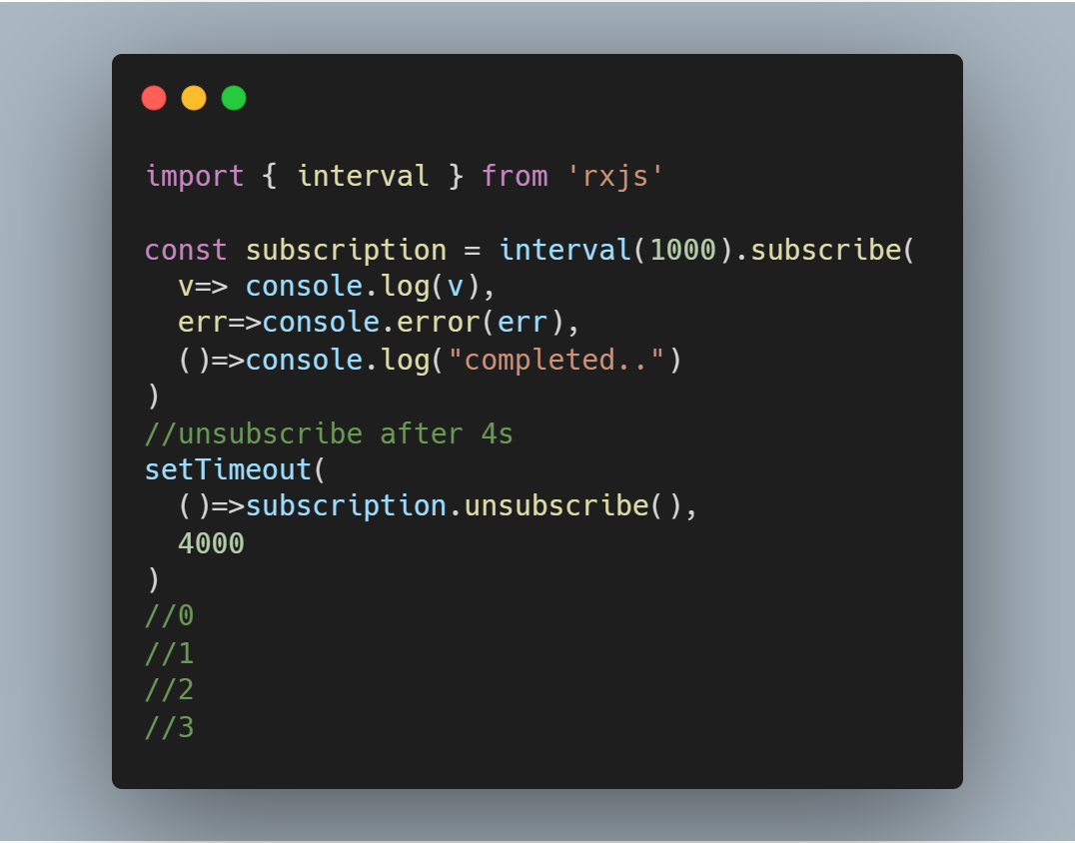
What is a Subscription?
A Subscription is an object that represents the execution of an Observable.
A Subscription has an unsubscribe() function to release resources or cancel Observable executions.

Slide 20
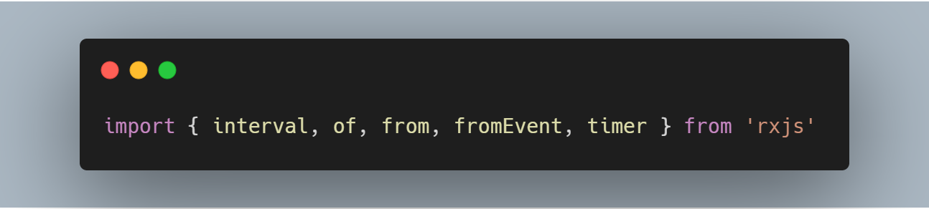
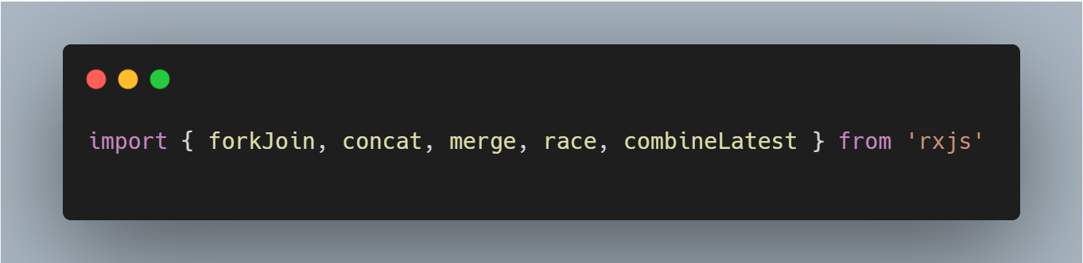
Operators
Creation Operator
Join Creation Operators

Slide 21
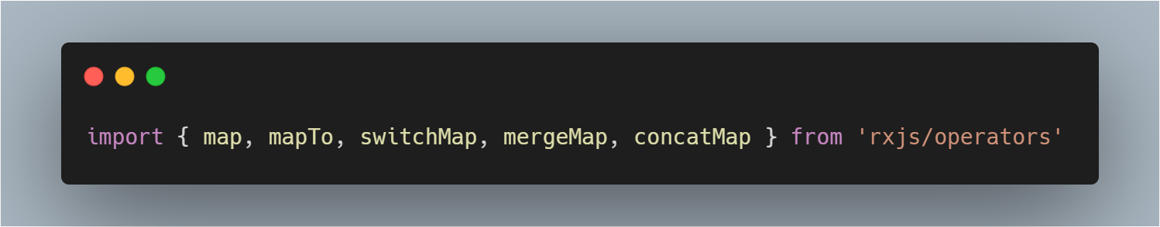
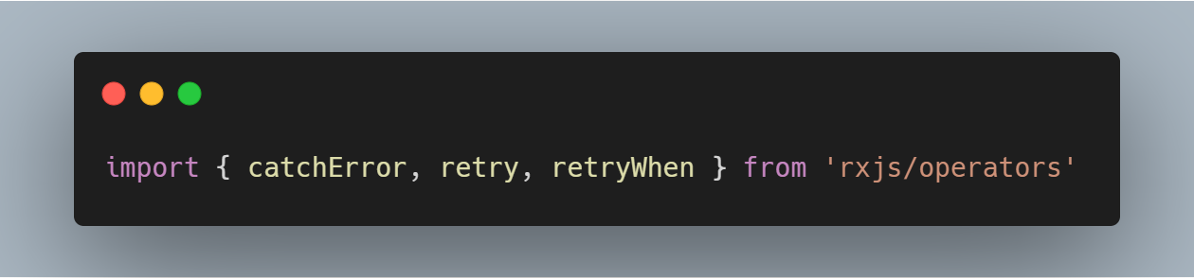
Operators
Transformation Operators
Error Handling Operators

Slide 22
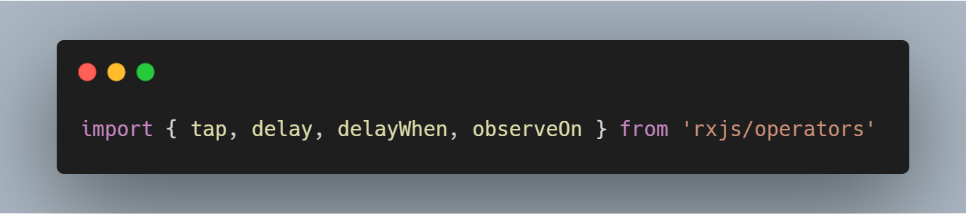
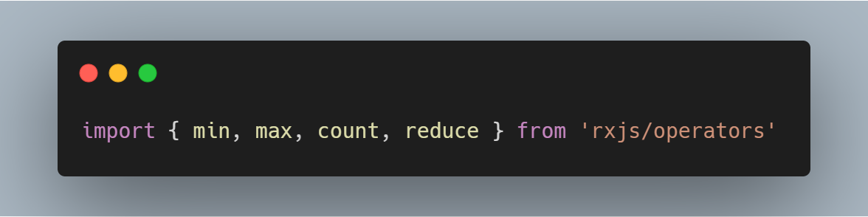
Operators
Utility Operators
Mathematical and Aggregate Operator

Slide 23
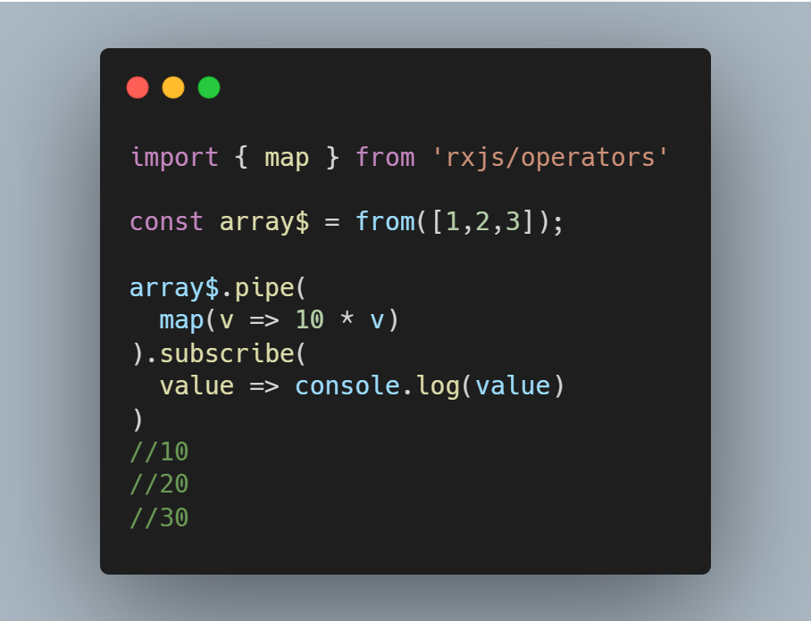
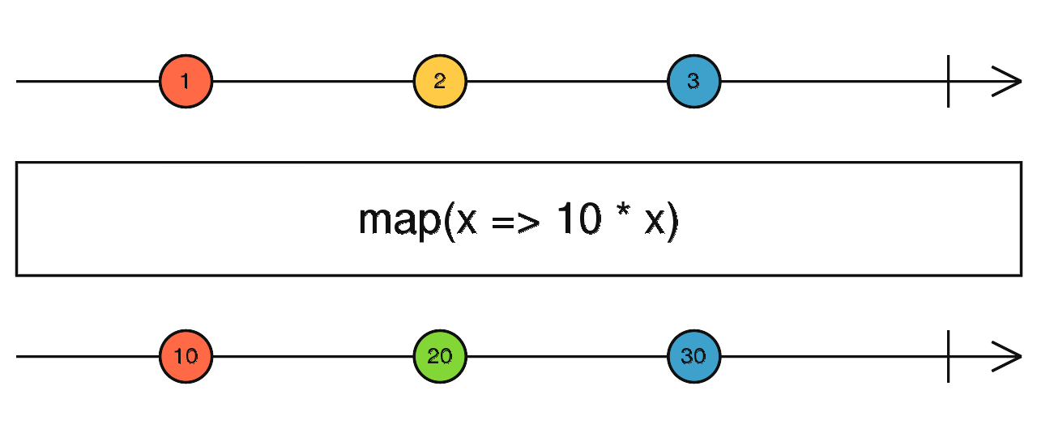
Operators
map()
Like Array.prototype.map(), it passes each source value through a transformation function to get corresponding output values.

Slide 24
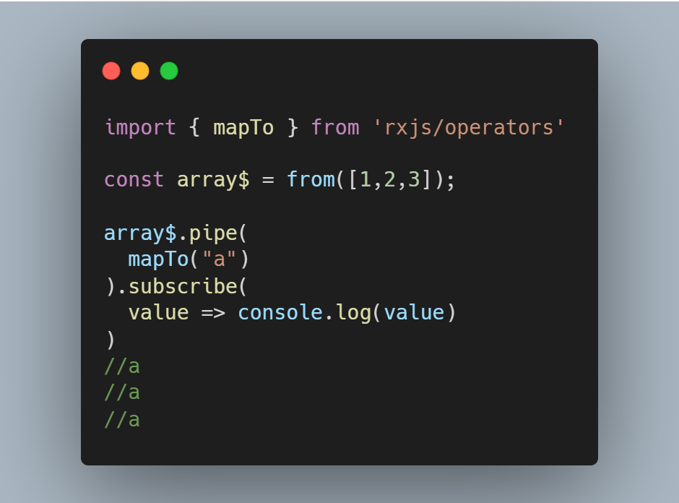
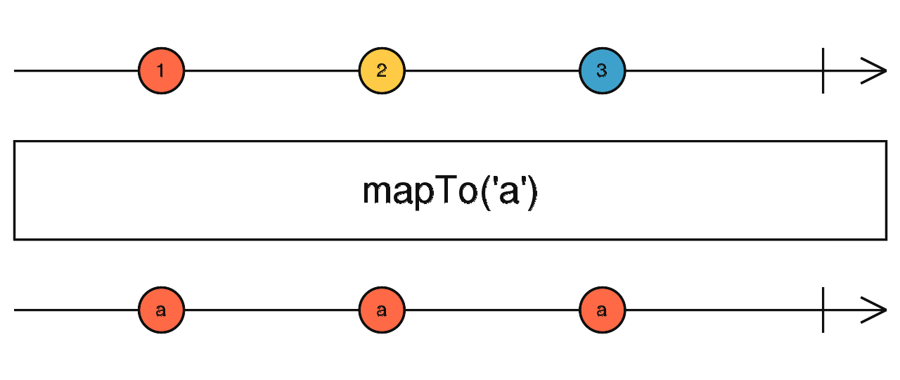
Operators
mapTo()
Like map, but it maps every source value to the same output value every time.

Slide 25
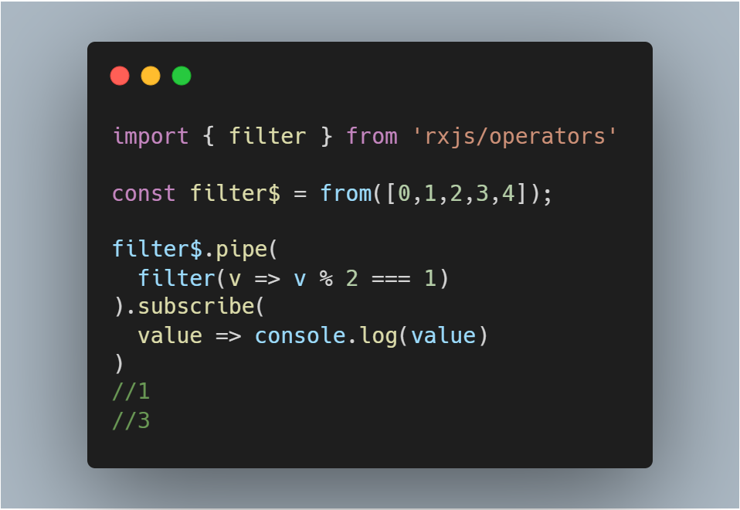
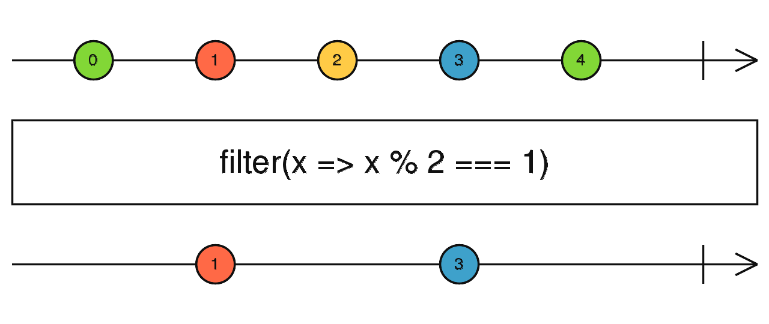
Operators
filter()
Like Array.prototype.filter(), it only emits a value from the source if it passes a criterion function.

Slide 26
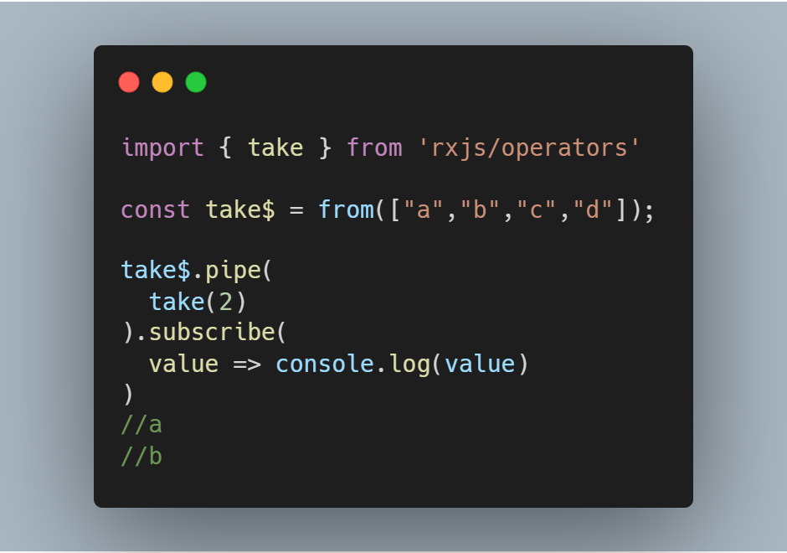
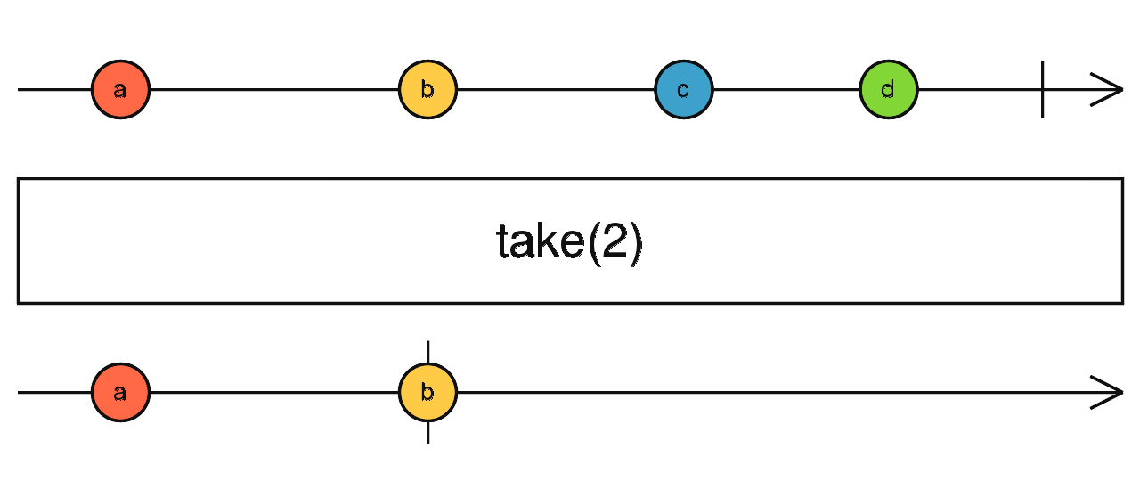
Operators
take()
Takes the first count values from the source, then completes.

Slide 27
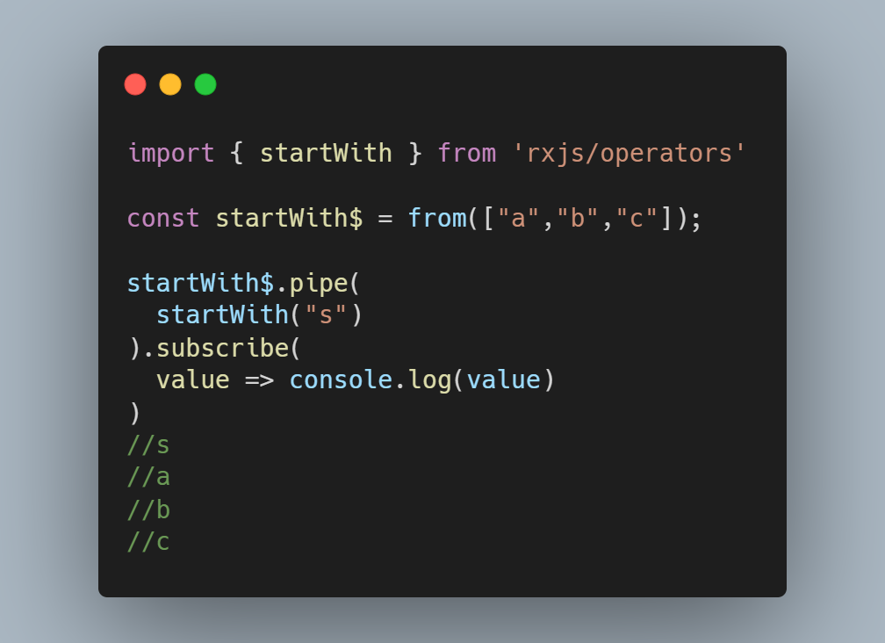
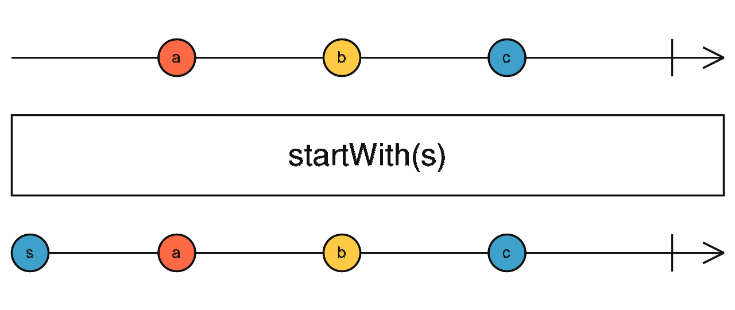
Operators
startWith()
First emits its arguments in order, and then any emissions from the source.

Slide 28
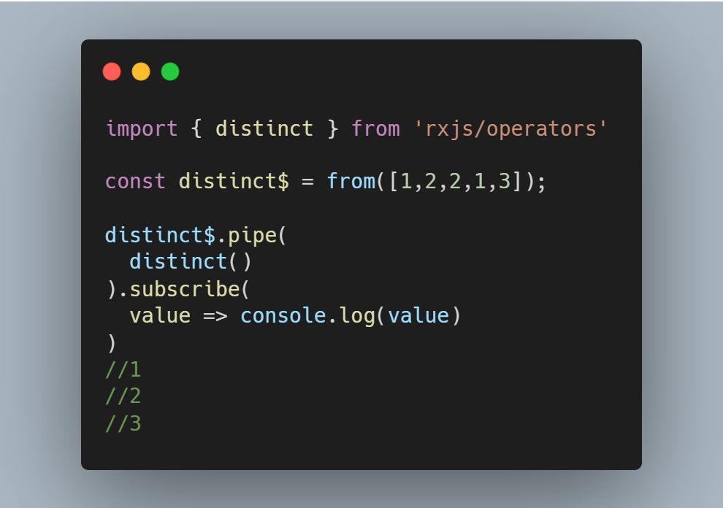
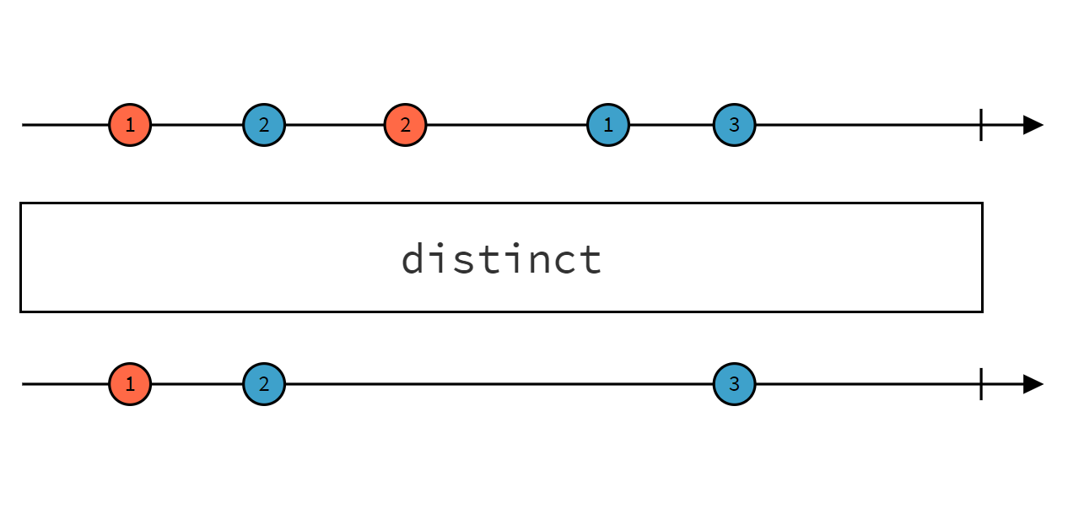
Operators
distinct()
It's like filter, but just emits the values that are distinct from all the previous.

Slide 29
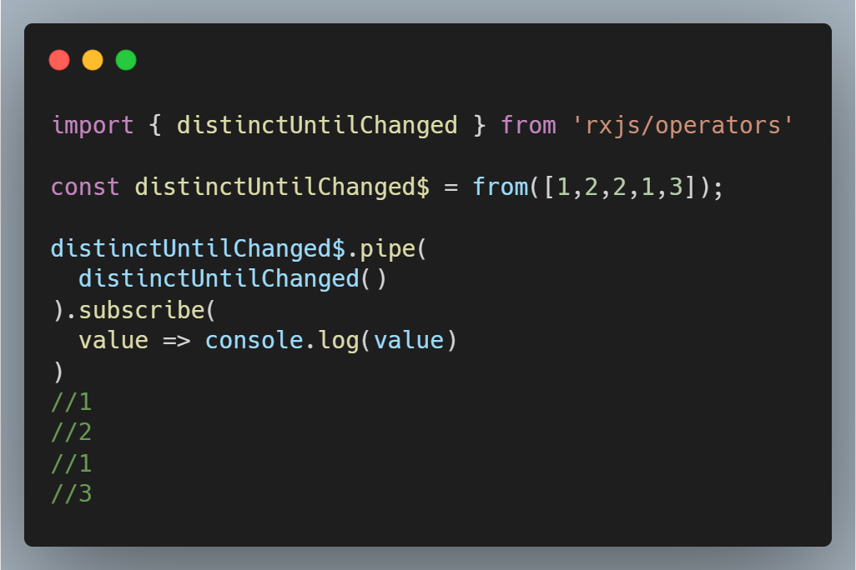
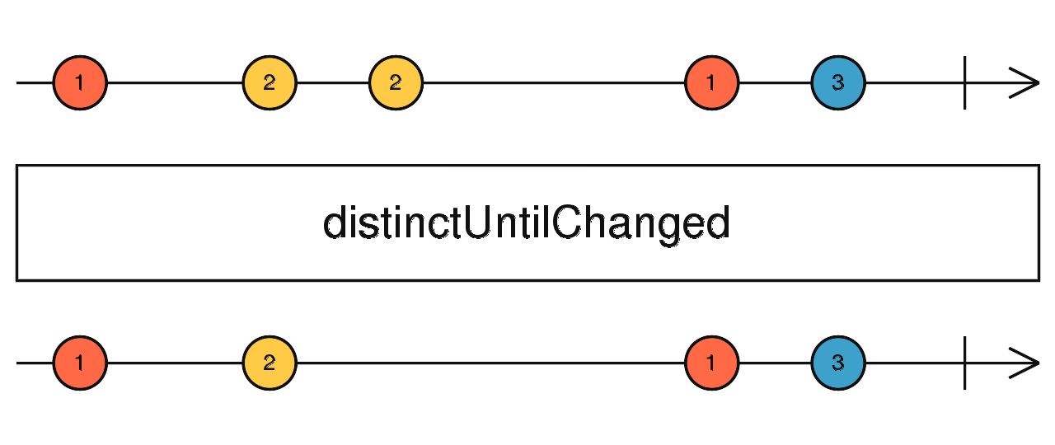
Operators
distinctUntilChanged()
It's like filter, but just emits the values that are distinct from the previous.

Slide 30
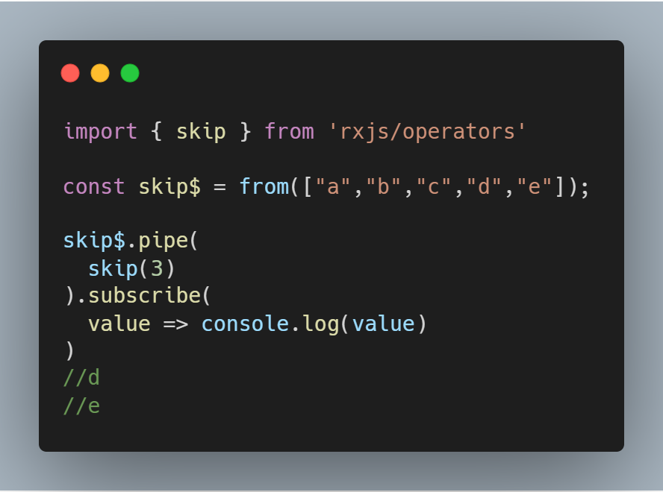
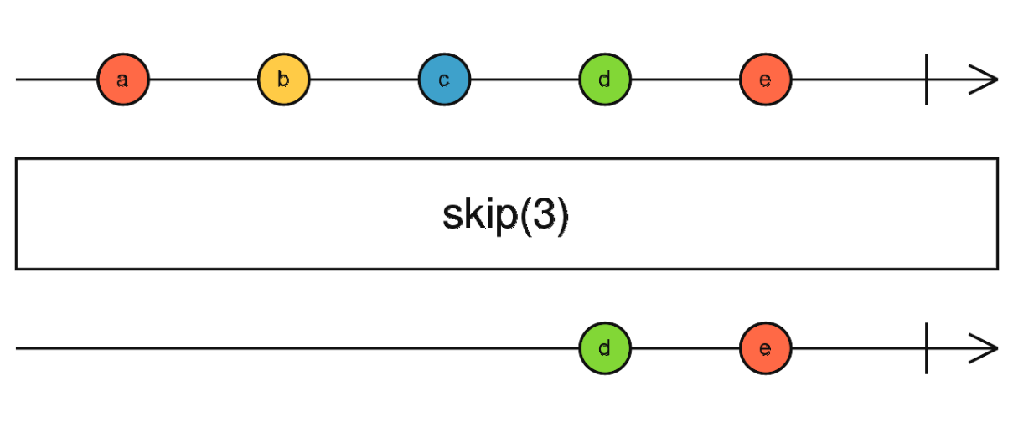
Operators
skip()
Skip the first count items emitted by the source Observable.

Slide 31
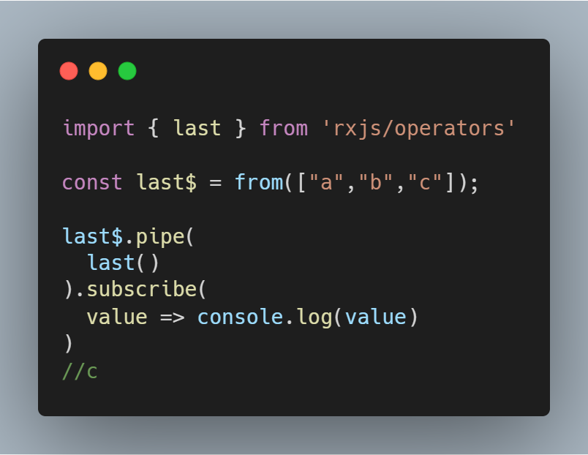
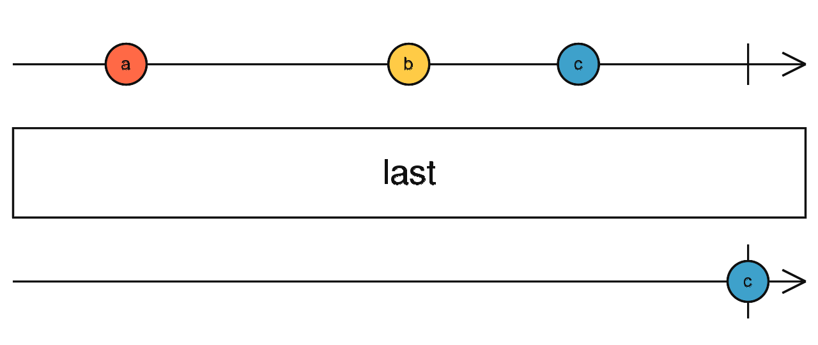
Operators
last()
Emit only the last item emitted by the source Observable

Slide 32
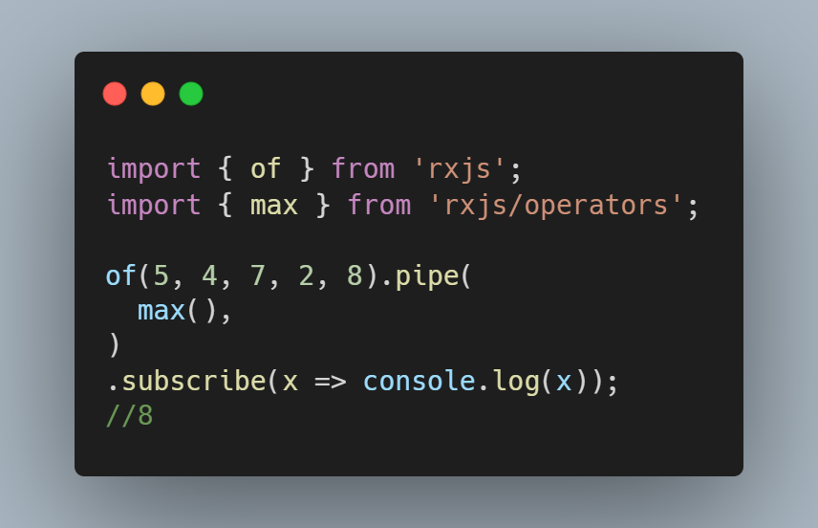
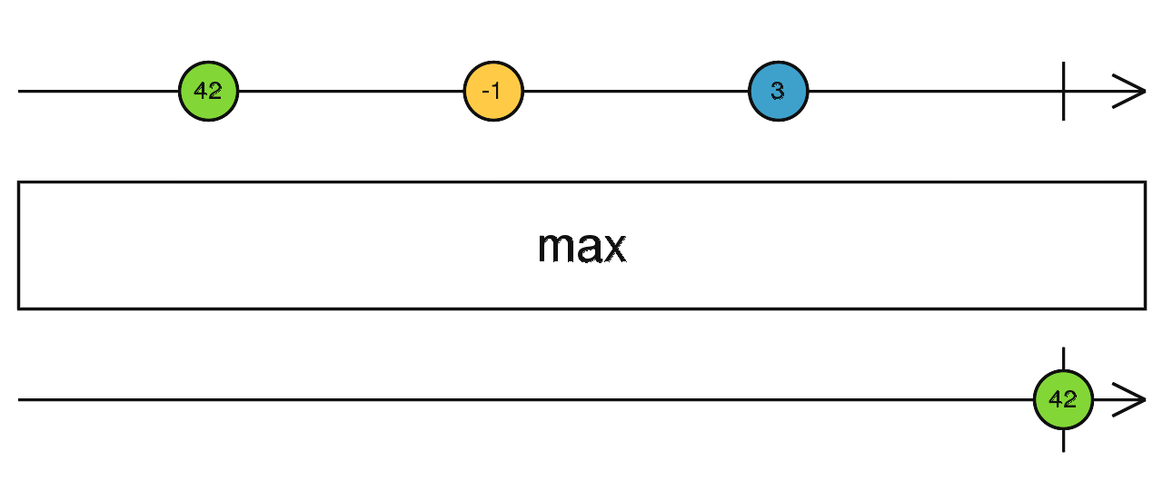
Operators
max()
Emit the largest value.

Slide 33
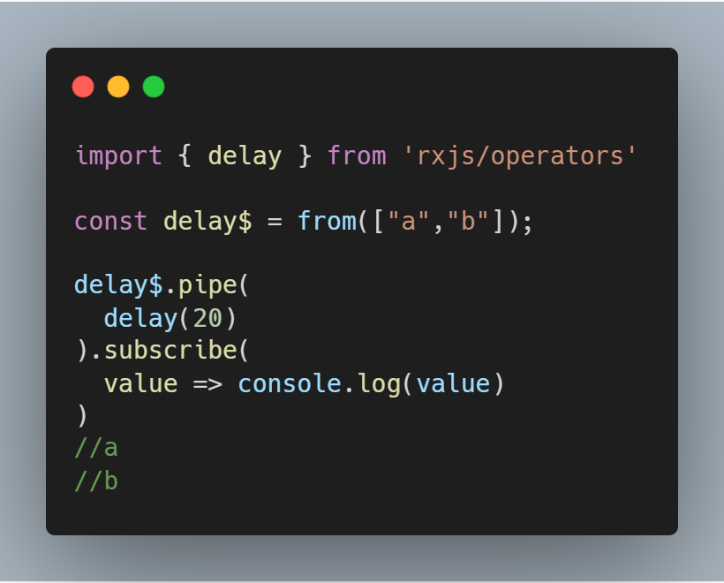
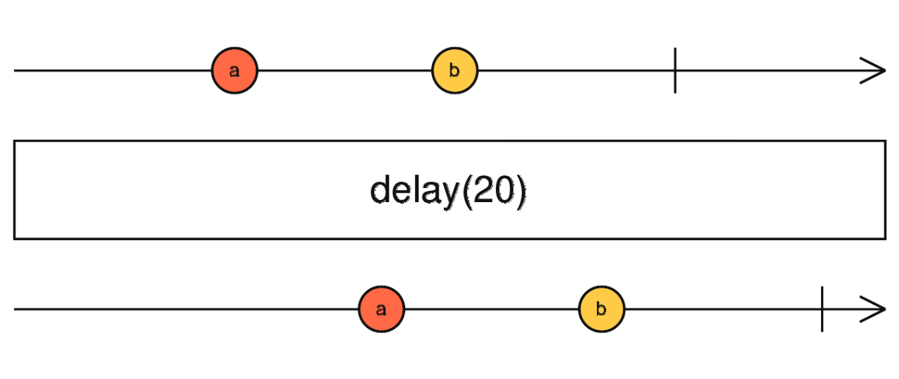
Operators
delay()
Time shifts each item by some specified amount of milliseconds.

Slide 34
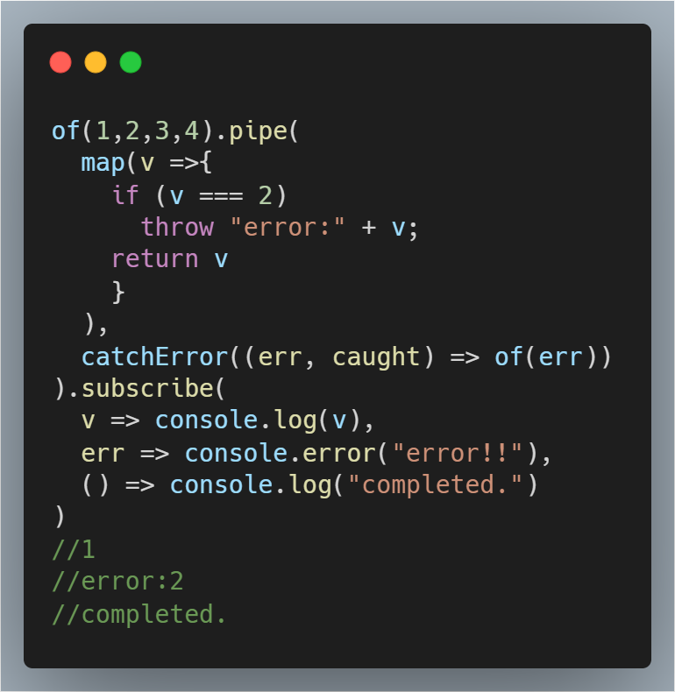
Operators
catchError()
Catches errors on the observable to be handled by returning a new observable or throwing an error.

Slide 35
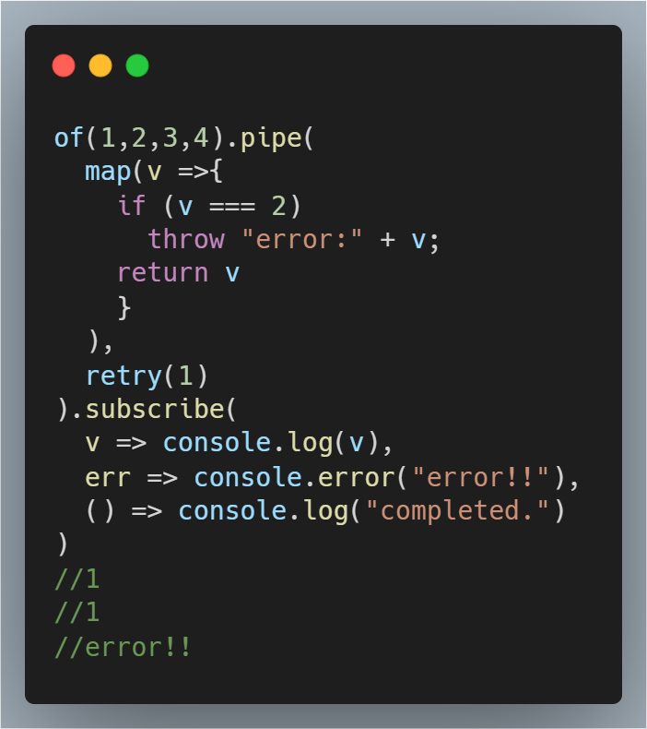
Operators
retry()
If the source Observable calls error, this method will re-subscribe to the source Observable for a maximum of count re-subscriptions (given as a number parameter) rather than propagating the error call.

Slide 36
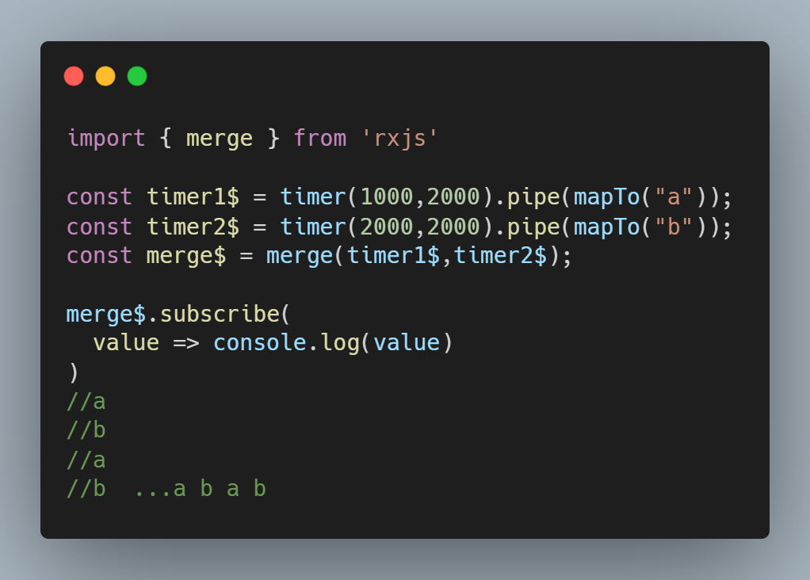
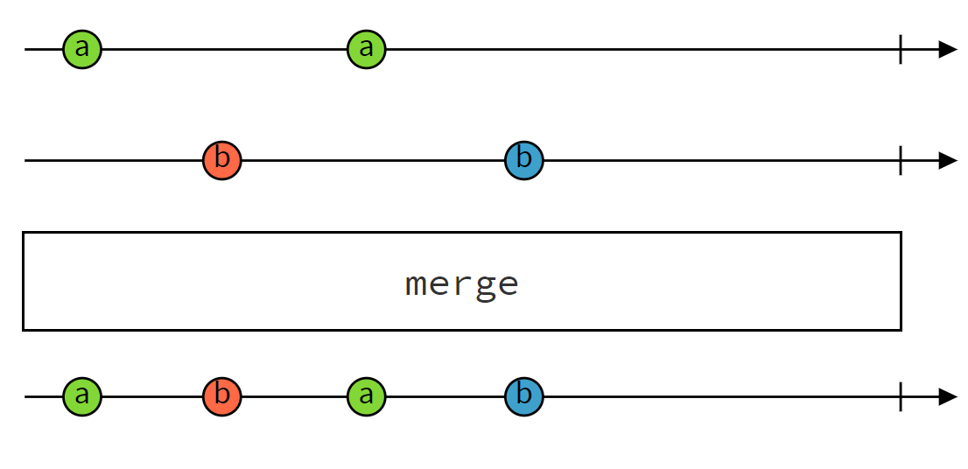
High-Level Operators
merge()
Flattens multiple Observables together by blending their values into one Observable.

Slide 37
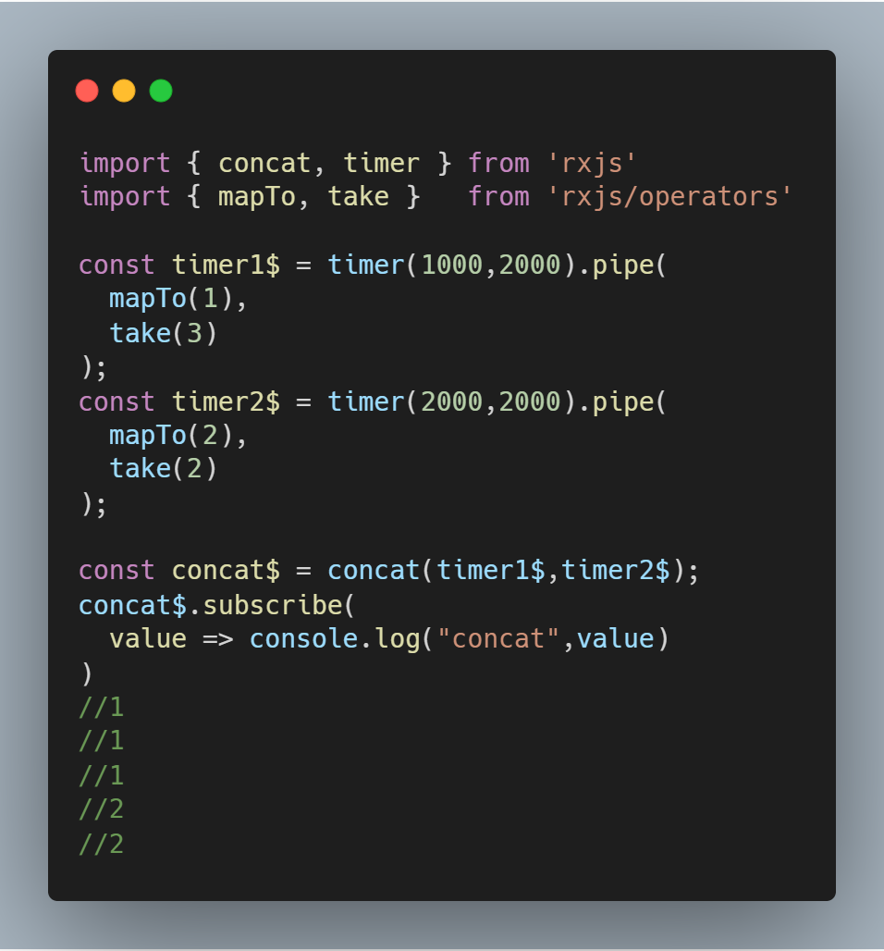
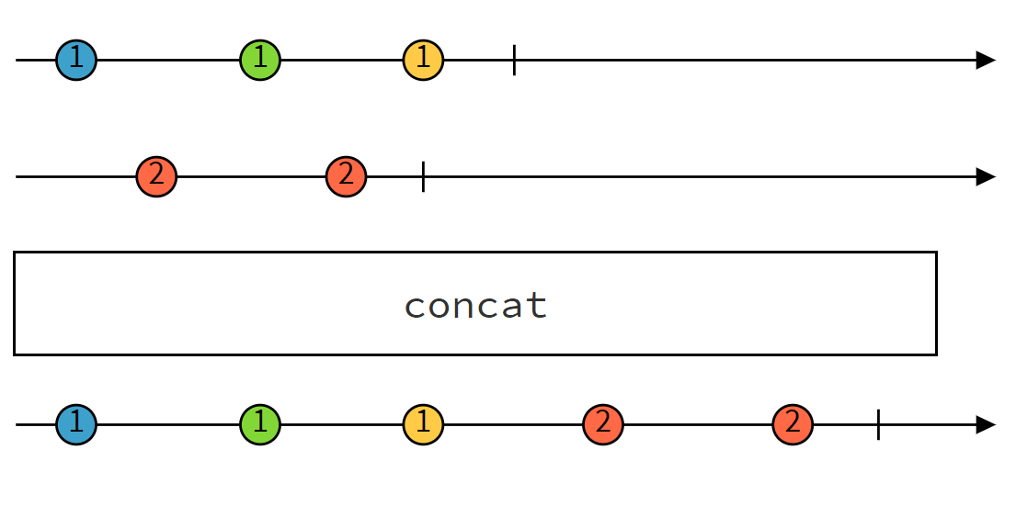
High-Level Operators
concat()
Concatenates multiple Observables together by sequentially emitting their values, one Observable after the other.

Slide 38
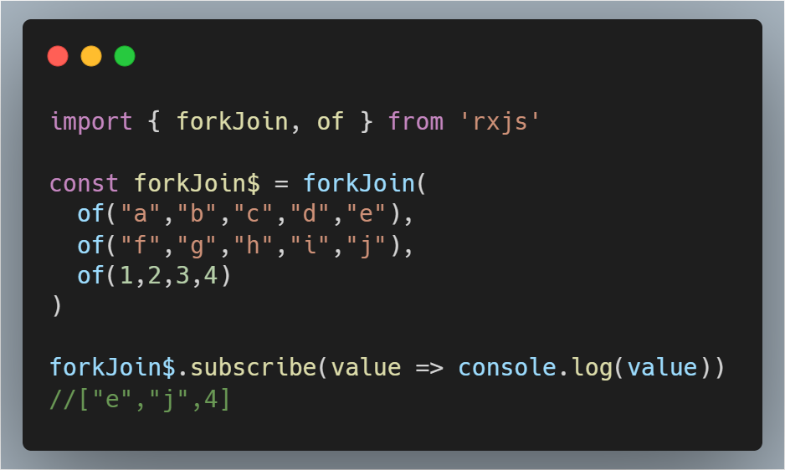
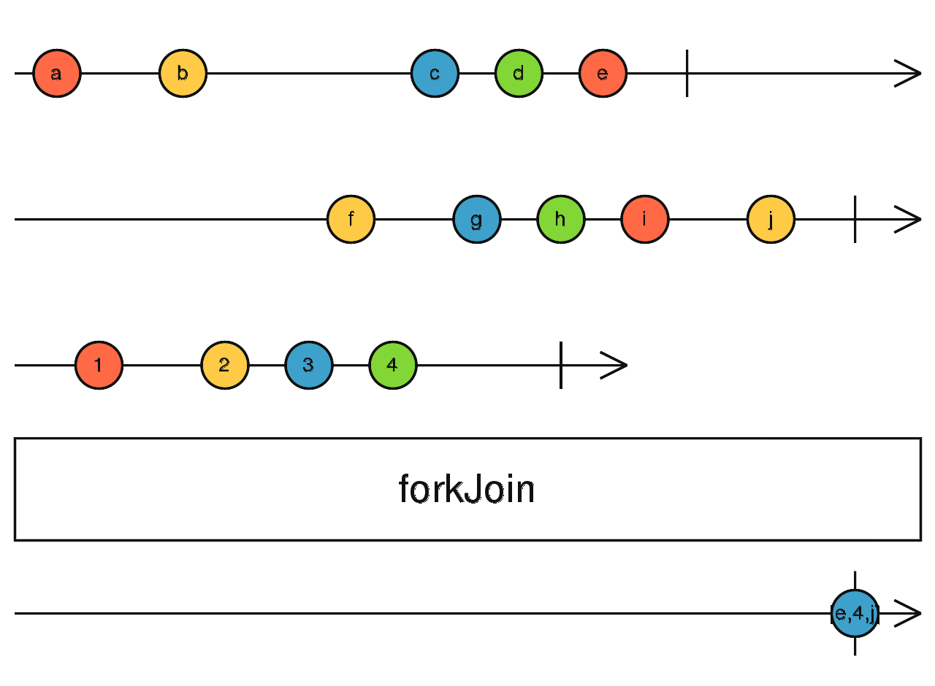
High-Level Operators
forkJoin()
Wait for Observables to complete and then combine
last values they emitted.

Slide 39
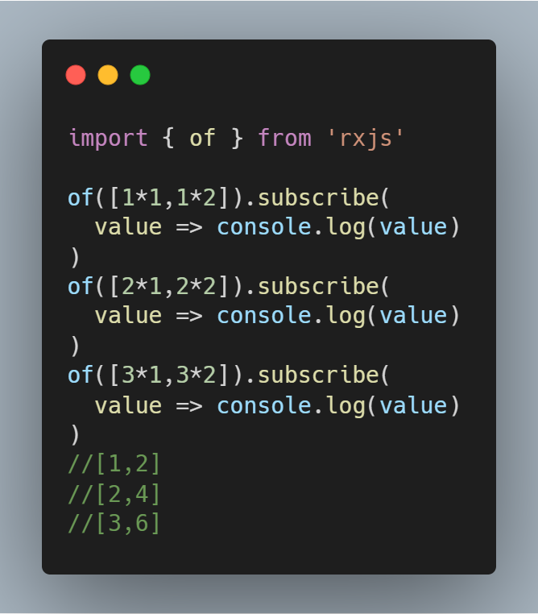

High-Level Operators
switchMap()
Maps each value to an inner Observable

Slide 40

High-Level Operators
switchMap()
Cancel previous uncomplete inner Observable

Slide 41

High-Level Operators
concatMap()
Map each value to inner observable, subscribe and emit in order.

Slide 42

High-Level Operators
mergeMap()/flatMap()
Map each value to inner observable, subscribe and emit asynchronously.

Slide 43


Subject
Every Subject is an Observable and an Observer. You can subscribe to a Subject, and you can call next to feed values as well as error and complete.

Slide 44

Scheduler
A Scheduler lets you define in what execution context will an Observable deliver notifications to its Observer.
asyncScheduler
asapScheduler
queueScheduler
animationFrameScheduler

Slide 45

Scheduler

Slide 46

Scheduler

Slide 47


Scheduler
observeOn is an operator that accepts a scheduler as a first parameter, which will be used to reschedule notifications emitted by the source Observable.

Slide 48

Event Loop in JavaScript
macrotasks: setTimeout, setInterval, setImmediate, I/O, UI rendering
microtasks: Promises, process.nextTick, MutationObserver

Slide 49
Live demo resources
Create Observables
Subscribe to an Observable
Operators
High-Level operators
Subject
Scheduler
demo-accumulation
demo-search-box

Slide 50




Thanks

